Slide 1
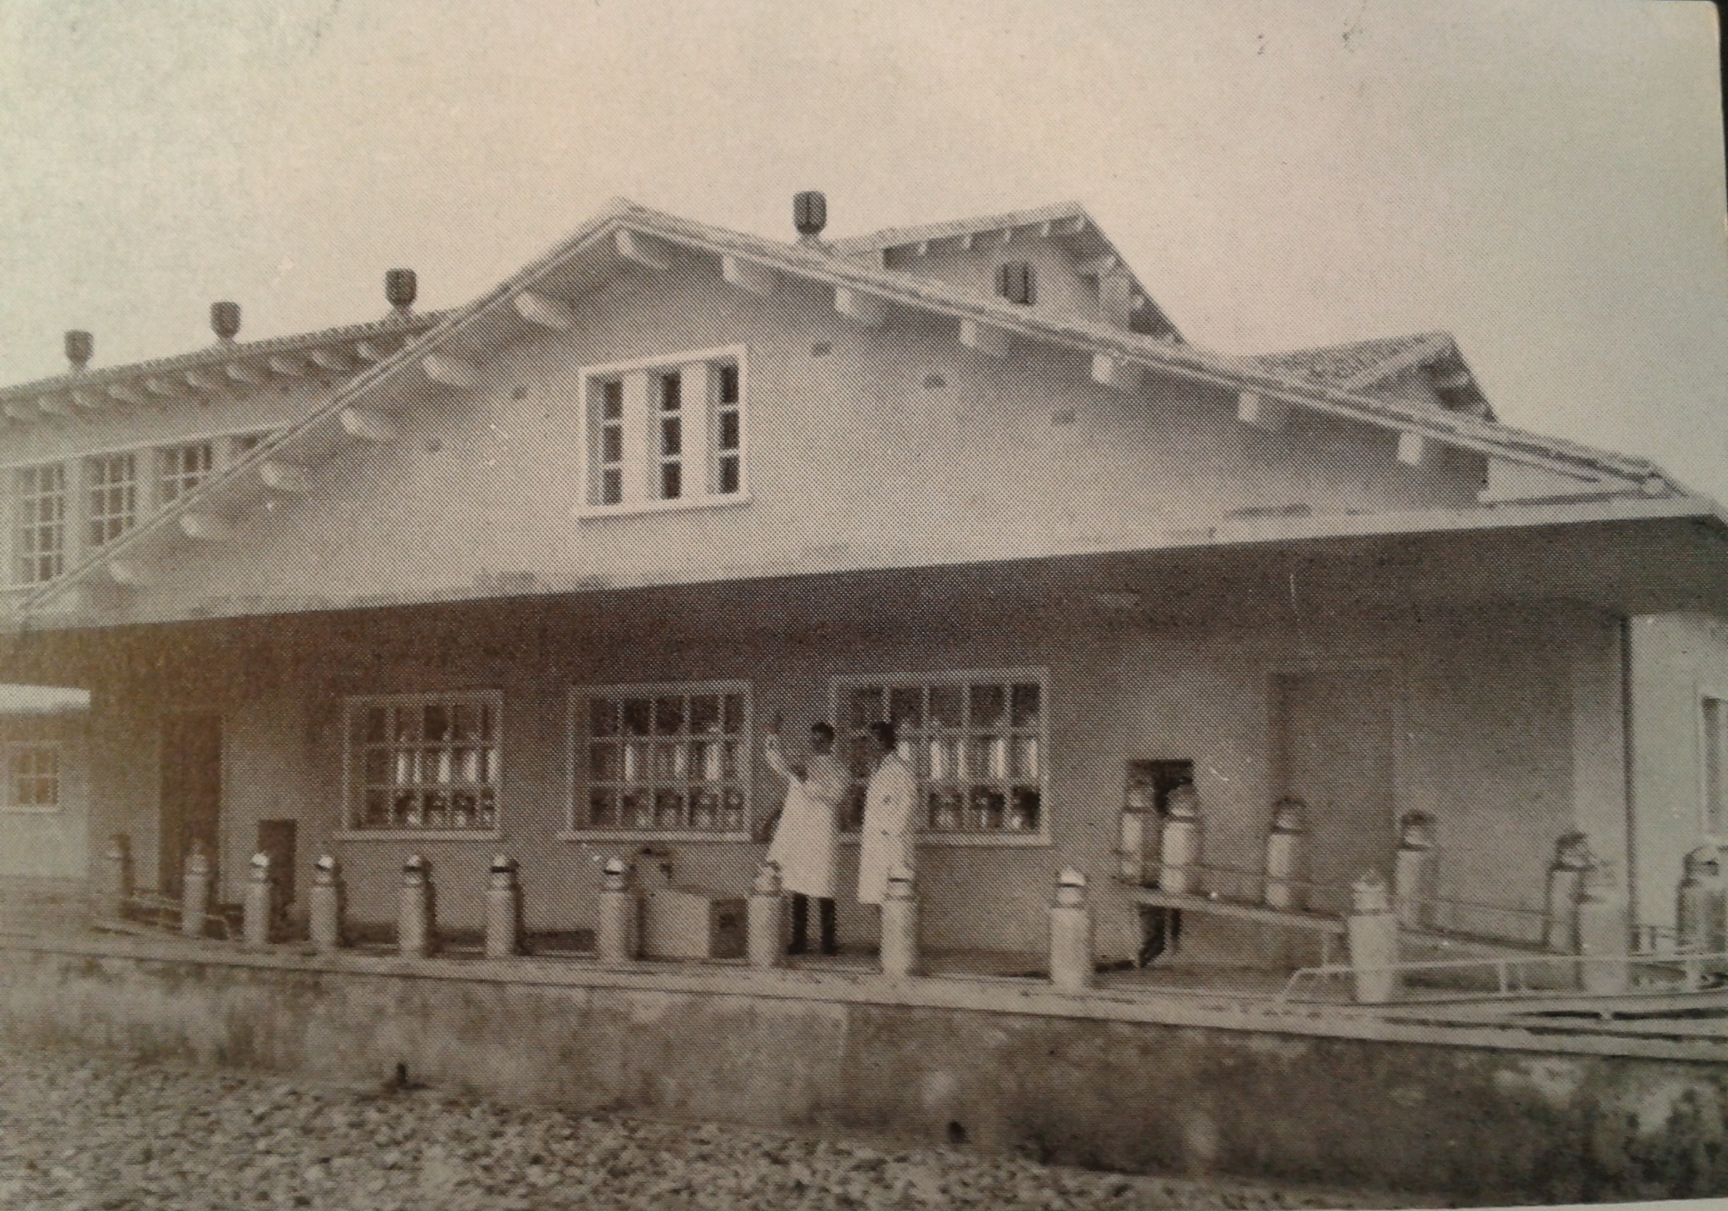
Food system dynamics and the nutritional transition: expensive milk, selective lactophiles and the slow spread of dairy products in the Spanish diet, 1950-1965 Fernando Collantes (collantf@unizar.es)

Slide 2
QUESTIONS Why was the consumption of dairy products so low in Spain as late as the mid-1960s? Whater are the drivers of the nutritionall trnasition??)

Slide 5
QUESTIONS Why was the consumption of dairy products so low in Spain as late as the mid-1960s? What were the drivers of the “nutritional transition”?

Slide 6
ANSWERS (SO FAR) Climate Poverty Environmental and developmental explanations on trial (I): supporting evidence Environmental and developmental explanations on trial (II): loose ends

Slide 7
ANSWERS (SO FAR) Climate Poverty Environmental and developmental explanations on trial (I): supporting evidence Environmental and developmental explanations on trial (II): loose ends

Slide 8
ANSWERS (SO FAR) Climate Poverty Supporting evidence for environmental and developmental explanations Loose ends

Slide 10
ANSWERS (SO FAR) Climate Poverty Supporting evidence for environmental and developmental explanations Loose ends

Slide 12
A REFORMULATION Theory: a structurist ontology for Malassis’ synthesis Evidence: dairy inflation and consumer responsiveness

Slide 13
A REFORMULATION Theory: a structurist ontology for Malassis’ synthesis Evidence: dairy inflation and consumer responsiveness

Slide 15
EXPLORING INFLATION AND CONSUMER RESPONSIVENESS Dairy inflation: backward farmers or something else? Low consumer responsiveness: lactophobes or selective lactophiles?

Slide 16
EXPLORING INFLATION AND CONSUMER RESPONSIVENESS Dairy inflation: backward farmers or something else? Low consumer responsiveness: lactophobes or selective lactophiles?

Slide 18
EXPLORING INFLATION AND CONSUMER RESPONSIVENESS Dairy inflation: backward farmers or something else? Low consumer responsiveness: lactophobes or selective lactophiles?

Slide 20
CONCLUSION Environments, macroeconomic trends, and… the food system! Business history, consumer history, and… a new perspective on on the nutritional transition??

Slide 21
CONCLUSION Environments, macroeconomic trends, and… the food system! Business history, consumption history, and… a more realistic perspective on the nutritional transition?

